Slide 1
TravelSavvy Using ML
Group No: CSE G-06
Roll Number
20211CSE0522
20211CSE0529
20211CSE0530
Student Name
Aditi Talekar Abhijeet Singh
Kumar Swarnim
Under the Supervision of,
Ms. Sreelatha P.K Assistant Professor
School of Computer Science Engineering & Information Science Presidency University

Slide 2
Introduction
The "TravelSavvy Using ML" aims to addresses the challenge by providing an integrated platform that consolidates all aspects of travel into one cohesive system. Utilizing the power of machine learning (ML), this solution personalizes the travel experience, offering users tailored itineraries, travel updates, optimized route suggestions, and recommendations based on their preferences, habits, and interests. By analyzing historical data and information such as weather, traffic, machine learning algorithms enhance the decision- making process for travelers, helping them discover attractions, plan routes, and avoid common travel disruptions.

Slide 3
Literature Review
Machine Learning in Tourism:
Machine learning improves tourism apps by tailoring itineraries, suggesting attractions, and enhancing decision-making based on user preferences and habits.
Fragmentation in Tourism Apps:
Travelers often rely on multiple apps for booking, navigation, and recommendations, leading to a fragmented and less cohesive experience.
User Experience and Satisfaction:
Seamless integration of booking, itinerary management, and real-time updates ensures a more satisfying and hassle-free user experience.

Slide 4
Research Gaps Identified
Lack of Real-Time Predictive Analytics
Numerous travel applications offer basic functionalities but do not utilize real- time data for predictive analytics, which could significantly improve the user experience.
Limited Personalization
Many existing travel systems provide only basic customization features and do not offer in- depth personalization grounded in user preferences, behaviors, and past experiences
Scalability Issues in Current Systems
Current travel solutions frequently encounter scalability challenges, particularly as the number of users and data increases. Many platforms are not equipped to manage the escalating complexity of user needs, especially as tourism expands to encompass local, regional, and international travel.

Slide 5
Proposed Methodology
Requirements gathering and Analysis
The initial phase in creating this application involves performing comprehensive research to grasp user requirements, business objectives, and possible technical obstacles.
System Architecture Design
The architecture of the system will be crafted to provide scalability, excellent performance, and a smooth user experience across different platforms.
Testing And Quality Assurance
To guarantee that the application satisfies user needs and operates smoothly, thorough testing will be conducted throughout the development process.

Slide 6
Objectives
The main goal of the "Travel Savvy using ML" project is to create a comprehensive platform that combines a range of crucial travel services, improving the overall travel experience from beginning to end.
Develop a Unified Travel Platform: The project aims to centralize essential travel services such as booking, itinerary creation into a single, user-friendly platform. It simplifies travel planning and ensures a seamless experience from start to finish.
Personalized Travel Recommendations: Leveraging machine learning, the platform analyzes user preferences, travel history, to provide tailored suggestions for destinations, accommodations, and activities.
Multi-Language and Multi-Currency Support Responsive and Cross-Device Compatibility: The platform ensures global accessibility by offering multi-language support and accommodating various currencies for seamless transactions
Sustainability: Promote eco-friendly travel options and track carbon footprints.

Slide 7
System Design& Implementation
The "Travel Savvy using ML" system utilizes a client-server architecture, which ensures a clear separation of responsibilities between the frontend (client-side) and backend (server-side). This structure facilitates efficient data flow and user interaction, enabling the platform to scale in response to increasing user demand.

Slide 8
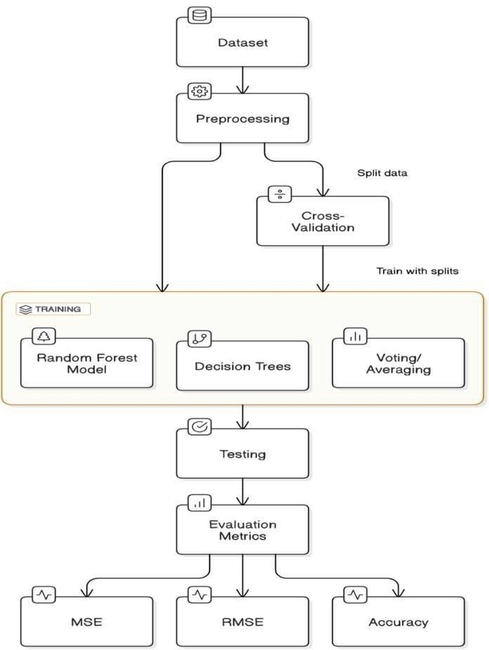
Fig. ML Architecture

Slide 9
The image presented outlines the process for constructing and assessing a Random Forest model in the realm of supervised learning. Below is a comprehensive breakdown of each phase illustrated in the diagram:
1.Dataset
The procedure starts with a dataset that comprises features (input variables) and a target
variable (output). This dataset forms the basis for training the Random Forest model. It is
essential to ensure the dataset is extensive, well-organized, and reflects the problem being addressed.

Slide 10
Prior to modeling, the data goes through preprocessing. This stage guarantees that the dataset is in an appropriate format for machine learning. Common preprocessing activities include:
2. Preprocessing
Addressing missing values
Normalizing or standardizing features
Encoding categorical variables
Selecting or extracting features
3.Cross-Validation
Following preprocessing, the dataset is divided into subsets for cross-validation, a method
used to assess the model’s performance. It separates the data into training and validation
sets, allowing the model to be tested on data it hasn't seen before. Cross-validation helps mitigate over fitting by confirming that the model can generalize effectively across various subsets of the data.

Slide 11
The primary phase of the workflow is training the Random Forest model. This step
4.Training
includes:
Decision Trees: The Random Forest builds numerous decision trees, each trained on a random sample of the data. These trees individually predict the target variable.
Voting/Averaging: After training, the predictions from all decision trees are combined. In
regression scenarios, the predictions are averaged, while in classification tasks, majority voting is utilized. This ensemble method improves the model's robustness and accuracy by decreasing the variance linked to individual decision trees.

Slide 12
After training is complete, the model is evaluated using a distinct dataset (frequently referred to as the test set) that was not involved in the training process. This stage assesses how effectively the model generalizes to new, unseen data.
5.Testing

Slide 13
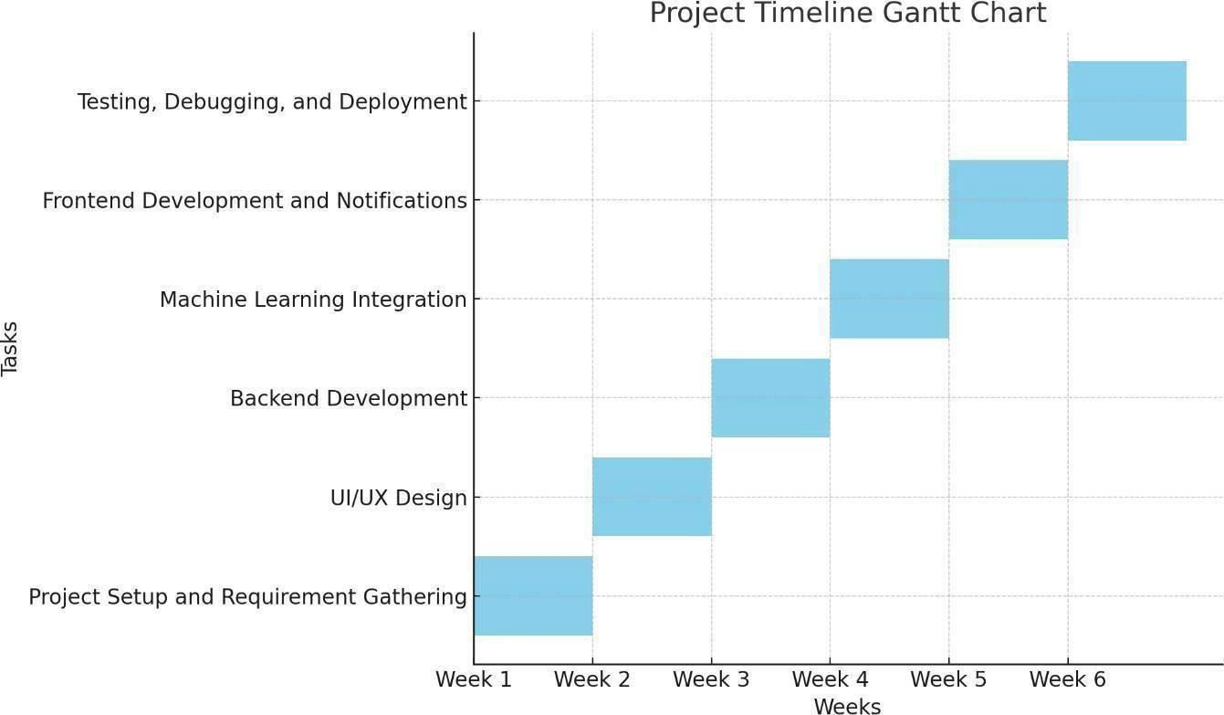
Timeline of Project

Slide 14
Outcomes / Results Obtained
Outcomes of the " TravelSavvy using ML" app include allowing users to easily manage their trips, accommodations within a single platform. Users will benefit receiving updates on weather, traffic, and travel disruptions, which enhances their overall travel experience.

Slide 15
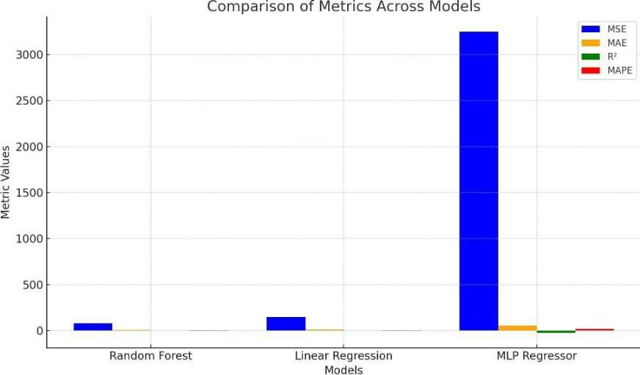
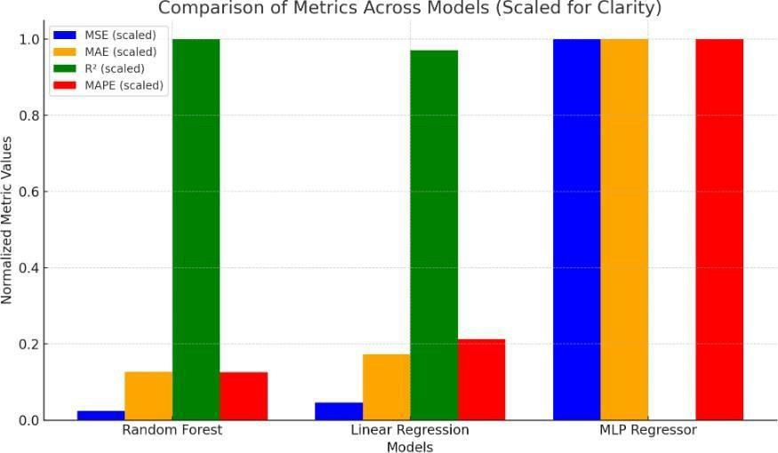
Result For ML Models
Fig. Comparison Of Models

Slide 16
Based on the evaluation metrics provided, the Random Forest Regressor stands out as the most effective model in this analysis. Here’s the reasoning:
It has the lowest MSE (Mean Squared Error) of 79.0323, which suggests that its predictions are, on average, the closest to the actual values when compared to the other models.
The Random Forest's MAE (Mean Absolute Error) of 7.0897 signifies that the average size of the errors is the smallest, indicating better accuracy in predicting individual data points.
With an R² (Coefficient of Determination) value of 0.4162, the Random Forest accounts for 41.62% of the variance in the target variable, which is substantially better than the negative R² values found in the other models.

Slide 17
The MAPE (Mean Absolute Percentage Error) of 2.5037% reflects that predictions differ from the actual values by only about 2.5% on average, excellent performance.
the model's which is an
Evaluation of Alternative Models:
Linear Regression demonstrates moderate MSE and MAE, but its negative R² value (- 0.2606) indicates it is less effective than merely predicting the mean of the target variable, revealing a poor model fit.
The MLP Regressor shows the least favorable performance in all metrics, recording a high MSE (3245.5134), an MAE (55.7612), and a significantly negative R² (-22.9741), rendering it inappropriate for this dataset.

Slide 18
Conclusion
The TravelSavvy using ML app aims to transform the travel experience by integrating essential services like booking, itinerary creation, and real-time updates into a single, seamless platform. By utilizing machine learning for personalized recommendations and predictive analytics, the app caters to the unique preferences and needs of every traveler. With its intuitive and user-friendly design, it effectively addresses the challenges of fragmented travel planning, while ensuring convenience, efficiency, and enhanced decision-making for users. Additionally, the app offers multi-language and multi-currency support, making it accessible to a global audience. Features like dynamic budgeting tools, eco-friendly travel suggestions, and AI-driven insights further enhance the overall user experience, empowering travelers to plan smarter, travel sustainably, and enjoy every journey to the fullest.

Slide 19
References
1. Smith, J., & Taylor, A. (2021). Tourism and technology: A new paradigm. Journal of Travel Research, 58(4), 300-
315. https://doi.org/10.xxxx/jtr.2021.00345
Brown, P., & Green, K. (2019). Mobile applications in the tourism industry. Tourism Management, 45(2), 125-139. https://doi.org/10.xxxx/tm.2019.00987
Kumar, R., & Singh, M. (2018). The role of technology in modern travel and tourism. International Journal of Tourism Studies, 32(6), 455-470. https://doi.org/10.xxxx/ijts.2018.00623
Smart Traffic Analysis using Machine Learning
https://www.ijeat.org/wp-content/uploads/papers/v8i5S/E10410585S19.pdf
Smart Traffic Analysis using Machine Learning
https://www.researchgate.net/publication/372348375_Smart_Traffic_Analysis_using_Machine_Learning
Machine Learning for Traffic Analysis: A Review https://www.researchgate.net/publication/340636248_Machine_Learning_for_Traffic_Analysis_A_Review
Machine Learning for Traffic Analysis https://www.sciencedirect.com/science/article/pii/S1877050920305494

Slide 20

Thank You

